Slide 1
Modula2/ Modula3
Jackson Warren

Slide 2
The w’s
Who-what-where-when-why

Slide 3
The w’s
Who: Niklaus Wirth
What: Procedural programming language for Lilith personal workstations
Where: ETH in Zunich, Switzerland
When: Late 1970’s
Why: In the aim to correct deficiencies of Pascal

Slide 4
Niklaus Wirth
Feb 1934 – Current
Electrical Engineer from ETH (1959)
Masters in Laval, Canada (1960)
PhD at Berkeley California (1963)
Prof. at Stanford (63-67)
Retired (1999)
Major parts in the creation of EULER, ALGOL-W, MODULA, and PASCAL.

Slide 5
Improvements made
No goto statement
No dangling else
Fewer block structures (BEGIN…END) and endless loops
Reserved words are uppercase
Function/procedure types
I/O as separate library modules, not built-in
Simple coding w/ Module design>>>>>>>
Modula-2
Vs
Pascal

Slide 6
What is Modula-2
Designed for general purposes
Procedural Language
Support separate compiling and data abstraction

Slide 7
Modula 2 Compilers
Windows:
Linux:
GNU Modula 2
XDS Modula 2
Lots of them
M2f Modula 2
Gardens point Modula 2
MOCKA
ACK
Macintosh, OS…
DEC
FST 4.0 Modula 2
Bochs
FST
Strannik
ADW Modula 2

Slide 8
Still in use?
Kinda?
GLONASS
Modula 2 is still in use, and has patches as recent as March, 2021.
However, now, it is sparsely used and is no-where near ranking on todays scales
for popularity.
Mainly, it was a foundational language
Basic
Java
C#
Lost traction with Intel 386 – Possibly 520 users?
https://codelani.com/languages/modula-2.html

Slide 9
Support
https://stackoverflow.com/search?q=modula-3&s=9dde72d9-a848-4c48-a659-481fda4ba4dd

Slide 10
NOW FOR
Modula 3

Slide 11
WAYYYYY better right?

Slide 12
Not really
Nahhhh
Kinda flunked…

Slide 13
Brief History
1986, Maurice Wilkes proposed the updated version of Modula 2 (Modula 2+) be re-made into a successor – Modula 3.
Other influences include: Mesa, Modula 2, Cedar
Lead by a team this time agreeing on features to add/remove.
Had new additions, such as light threads of control, objects, generics, garbage collecting, subtyping (to name a few).
Removed several problematic features of Modula 2: Variant records and built-in unsigned numeric data.
Goal: Same as Modula 2 – Simple with comparable power
No new or fancy features

Slide 14
Maurice Wilkes

Slide 15
Use today:
Several uses in industry and research projects
Great teaching base
Emphasizes good structure
Many libraries to utilize
Support:
Elgo Software Solutions provides commercial support
https://stackoverflow.com/search?q=modula-3&s=9dde72d9-a848-4c48-a659-481fda4ba4dd

Slide 16
Used today?
Kinda?
https://codelani.com/languages/modula-3.html
Not adopted widely, and used sparsely
No longer updated
Similar platform support to Modula 2
Why did it flunk?
By this time, other languages had taken off and Modula was used as the stepping stone, but was no longer a big player

Slide 17
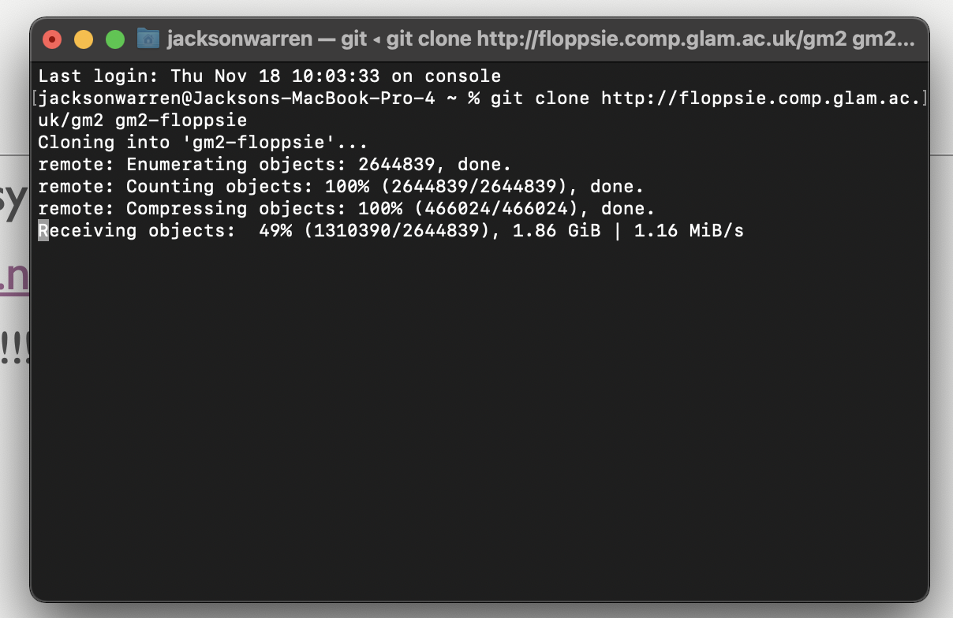
COde
Well, not so easy
https://www.nongnu.org/gm2/download.html
Mistakes!!!!!!
Once downloaded, only worse…
Ew
Such confusion

Slide 18
Code 2
https://www.modula2.org/tutor/chapter15.php
Ultimately, incredibly hard to code with (both 2 & 3)
Little support
Most links lead to dead ends for help
Use of compilers are unclear
Only one with good support is ADW (Windows)

Slide 19
So, why do we care?
Modula-2
Foundational language leading to the structure and ideology of most languages today
Simple/defined structure
Modula-3
Never really got traction
Other languages had taken off and left Modula-3 outdated

Slide 20
SOurces
https://www.modula2.org/modula-2.php
https://code.fandom.com/wiki/Modula-2
https://en.wikipedia.org/wiki/Modula-2
https://people.inf.ethz.ch/wirth/
https://amturing.acm.org/award_winners/wirth_1025774.cfm
https://freepages.modula2.org/compi.html
http://www.faqs.org/faqs/Modula-3-faq/

